Slide 1
Transitioning from the Navy
Notes:
Time Required: 50 min

Slide 2
Enabling Objectives
STATE the purpose of Transition Assistance Program (TAP)
IDENTIFY the Military Life Cycles
IDENTIFY the requirements of TAP
DESCRIBE Military Service Obligation (MSO) and 4-2-2 Military Service Obligation
STATE the purpose of the Navy Reserve
LIST the Navy Reserve categories
IDENTIFY the benefits of the Navy Reserve
IDENTIFY the Reserve Retirement requirements
DESCRIBE the functions of the Reserve Processing and Affiliation Center (RPAC)
IDENTIFY the role of the Command Career Counselor in the process to go Active Component to Reserve Component
Notes:
FACILITATOR GUIDE:
Review objectives.

Slide 3
References
NAVPERS 15878N: Career Counselor Handbook
NAVPERS 15560D: Navy Personnel Manual
OPNAVINST 1900.2D: Navy Transition Assistance Program (TAP)
OPNAVINST 1040.11F: Navy Enlisted Retention and Career Development Program
ALNAVRESFOR 015/22: The Mobilization Deferment Policy
RESPERSMAN M1001.5: Navy Reserve Personnel Manual
BUPERSINST 1001.39F: Administrative Procedures for Navy Reservists
NAVADMIN 259/24: SELRES Tuition Assistance Pilot Program
Website: https://www.mynavyhr.navy.mil/Career-Management/Transition/RPAC-Enlisted/
Notes:
FACILITATOR GUIDE:
Review references.

Slide 4
Transition Assistance Program (TAP)
Reference: Title 10 U.S.C., Sections 1142, 1143, 1144, DODI 1332.35, OPNAVINST 1900.2D
Purpose:
TAP provides separating/retiring service members and their families with the skills, tools and self-confidence necessary to successfully re-enter into the civilian work force, pursue higher education, or technical training
The goal of the program is to provide professional career development resources throughout the military career life cycle (MLC) to best ensure success post Military Service
Notes:
FACILITATOR GUIDE: Ensure ALL sailors regardless of reason (i.e. voluntary/involuntary) can properly transition to civilian force and be employed.
None

Slide 5
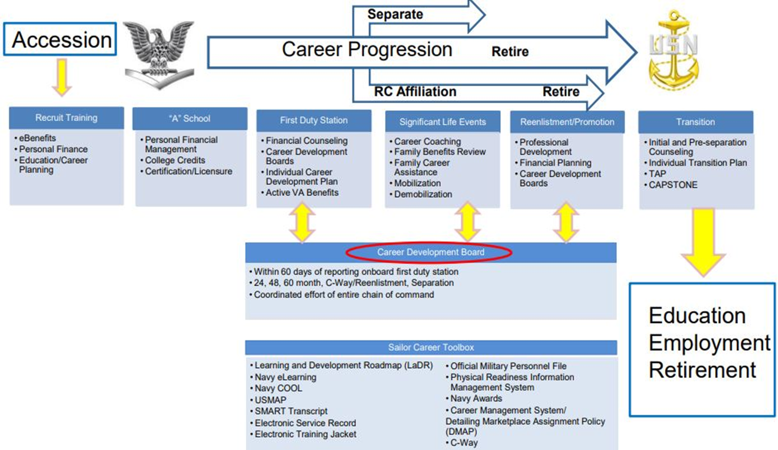
Transition Assistance Program Military Life Cycle
Notes:
FACILITATOR GUIDE: Paraphrase chart after review. In other words, your role as the CC, is to perform the CDB at different career milestones to ensure Sailor maximizes Navy opportunities to prepare them for a smooth transition from the military into the civilian sector.

Slide 6
Transition Assistance Program (cont.)
All Sailors serving on Active Duty greater than 180 days are required to complete TAP requirements and meet Career Readiness Standards (CRS)
Five key components of TAP
Mandatory initial counseling/self-assessment at least 365 days prior to separation
Mandatory pre-separation counseling at least 365 days prior to separation
Mandatory TAP core curriculum (3 Days of class provided by FFSC or TAP Online Courses via tapevents.mil/courses)
Selection of two-day track (if not waived)
Mandatory Capstone- Completed NLT 90 days prior to separation
CCC
Self-Assessment & Initial Counseling
Pre-Separation Counseling
DOD Transition Day
VA Benefits/
DOLEW Workshop
2-Day Career Track
CAPSTONE
Mandatory
Completed 365 days from separation
DAY 1
Mandatory
Completed 365 days from separation
DAY 2
Mandatory
My Transition
Military Occupational Code Crosswalk
Financial Planning
DAY 3
Mandatory
VA Benefits
Department of Labor Employment Workshop
DAY 4 & 5
• Employment Track • Education Track • Vocational Track • Entrepreneurship
Track
Must be completed no later than 90 days prior to separation
Completed by FFSC or CCC
Notes:
FACILITATOR GUIDE:
Key Components are the items that will be met throughout the process. It starts with the Sailor completing the Self-Assessment and initiating their eForm on MILCONNECT. Once registered for TAP class, the components met will happen during their course of instruction. Once they are completed and have all CRS met and completed, they will schedule their Capstone to be completed NLT 90 days from their separation.
Note: Sailors are required to complete Capstone prior to taking terminal leave or commencing SkillBridge.

Slide 7
Transition Assistance Program Career Readiness Standards (CRS)
To evaluate service members preparedness to successfully transition from a military to civilian career and to validate the they have met appropriate CRS based on the goals they intend to pursue after active-duty service.
Self-Assessment/Individual Transition Plan
Post-Transition Financial Plan
eBenefits registration
Continuum of Military Service brief (active duty only)
Gap Analysis or verification of employment
Completed Resume or provide verification of employment (based on track selection)
Comparison of Technical Instructions (based on track selection)
Comparison of College/Universities (based on track selection)
Notes:
FACILITATOR GUIDE:
Inform the audience that these are the Career Readiness Standards (aka CRS), in other words, expectations to meet to ensure they meet their desire post service goals. Some items can be waived and it will be based on their Tier and their Self-Assessment. Tier1 being low need (already have job lined up, or other income) Tier 2 (need help finding, preparing for employment) Tier 3 (HIGH Need). Tier 2-3 will have more requirements to meet and not as many Sailors fall into this category, but we must ensure they are hitting the extra requirements.

Slide 8
Military Service Obligation (MSO)
MILPERSMAN 1100-011
Personnel incur an 8-year MSO upon initial entry into any of the Armed Forces. This MSO can be accomplished by completing 8 years on active duty, inactive duty or a combination of both
Sailors that meet or exceed 8 years on active duty can still affiliate with the reserves and may reenlist with a reserve contract upon affiliation
MSO obligation is determined by the Date of Initial Entry into Military Service (DIEMS). DIEMS can be found on the Sailor’s DD Form 4 in their OMPF
The Navy’s MSO for those who entered prior to 1 October 2020, is 4 years active with 4 years in the IRR
Member may elect to affiliate with the SELRES but otherwise they are automatically transferred to the IRR after EAOS
For those sailor's entering (DD Form 4) on/after 1 Oct 2020, fall under the 4-2-2 program (discussed in next slide)
Notes:
FACILITATOR GUIDE:
All contracts will specify that after a Member has completed their active duty contract they will serve in either the SELRES, IRR or combination of the two based on the needs of the Navy to satisfy their 8 year MSO requirement.
If Sailors feel like there is a discrepancy it is always best to reach out to PERS or C-Way to obtain additional guidance. MSO is based on DIEMS date (Date of Initial Entry to Military Service) which will differ from PEBD/ADSD.
Understanding MSO start date will help later on when we discuss 4-2-2 program (4 years active, 2 year SELRES, 2 year IRR) because it often arises as a question from the transitioning Sailor.

Slide 9
Military Service Obligation (4-2-2)
NAVADMIN 303/23, MILPERSMAN 1306-1501
DIEMS on or after 1 October 2020, the new MSO requirement is 4-2-2
4 years active, 2 years MANDATORY SELRES obligation, 2 years IRR
Sailors that extend or reenlist past 6 years, will not be required to affiliate in the SELRES but may elect to.
If a Sailor completes more than 4 years but less than 6 years, they will have that time adjusted. (i.e. Sailor is on active duty for 4.5 years, they will do 1.5 years in the SELRES and 2 years in the IRR)
Career Waypoint will be utilized starting at 10 months prior to SEAOS and up to 4 months to their SEAOS to affiliate with SELRES.
Sailor’s whose ratings are not available in the SELRES (i.e. IC) are not required to affiliate with the SELRES and may transfer into the IRR or request conversion to a rate within the SELRES they qualify for.
Sailors enlisted under a PACT contract do not fall under 4-2-2.
Notes:
FACILITATOR GUIDE:
Sailors who fall under this program should be made aware of this at their reporting CDB. Sailors who are PACT or under special contracts are not under the 4-2-2 MSO but should be reviewed to ensure proper counseling is conducted and deadlines are not missed.
Additional CCC Roles in this process:
CCCs must identify all their 4-2-2 Sailors by using the CWAY module under the “Sailor Browser” or the through the Career Information Management System (CIMS) ALPHA Roster report.
For 4-2-2 Sailors who are separating and have remaining Military Service Obligation (MSO), CCCs must manually update Sailors in the CWAY module application as “Intends to separate” once they enter their window (10 mo. prior to their SEAOS) in order for a SELRES application to be “Auto Created”.
Once the applications are auto created in the CWAY module, CCCs must “Submit” each application individually, failure to do so will cause the application for the Sailor to remain as un-submitted and subsequently carry over to the “Failure to Submit” report.
Best practice – for these Sailors, CC's submitting Sailors to transition to SELRES in CWAY, this is the best time to initiate Sailor to review the Navy Reserve Onboarding website (gives lots of transition guidance to this new service component – may provide answers to questions they may have).
Additionally, completed the Reserve Affiliation Screening Checklist at Contact Information Sheet at the Bottom of page – GO LIVE TO WEBSITE--> https://www.mynavyhr.navy.mil/Career-Management/Transition/
EXTRA RESOURCE AVAILABLE (IF DESIRES/AS NEEDED< NOT REQUIRED) - JAN 2024 4-2-2 Program overview (Mr Ferguson BUPERS 3)
https://www.mynavyhr.navy.mil/Portals/55/Career/ECM/SelRes/MSO_4-2-2_BUPERS-352_CWAY.pdf?ver=8GCGJeWpF0W-ahQgjqRxyQ%3D%3D#:~:text=I%20hereby%20acknowledge%20that%20I,11%20Enlisted%20Communities

Slide 10
Individual Ready Reserve (IRR)
Sailors transitioning into the IRR are required to be counseled on their requirements prior to separation.
NOTE: IRR Counseling requirements can be found in MILPERSMAN 1001-145.
Sailors in the IRR are:
Not affiliated with a drilling unit
Not eligible for advancement
Required to maintain their physical fitness standards and medical readiness
Respond to official correspondence and complete their Annual Screening
Keep uniforms in serviceable condition
Notes:
FACILITATOR GUIDE: REF: MPM 1001-145 Overview (as needed) > https://www.mynavyhr.navy.mil/Career-Management/Reserve-Personnel-Mgmt/IRR/
Members may enter the IRR for several reasons: Fulfill MSO, upon request (if eligible), SELRES receiving disability, HYT and other personal reasons.
Advised CDT to review MPM 1001-125.
CCC are responsible for counseling separating members utilizing NAVPERS 1070/613 and ensuring that NAVPERS 1070/613 is added to the separating service member’s OMPF.
3. IRR FAQs can be retrieved from the link below:
https://www.mynavyhr.navy.mil/Career-Management/Reserve-Personnel-Mgmt/IRR/IRR-FAQ/
4. Difference between SELRES and IRR?
SELRES
Drill 2 days a month
Perform 12-17 days of active duty (annual training)
More temporary active duty opportunities (IF desired)
Benefits – Medical/Dental, Pay, SGLI, Advancement
IRR
No drilling but Navy asset
Required to respond annually to PERS while in this status (update recall address, maintain fitness, uniforms serviceable)

Slide 11
Navy Reserve
The Navy Reserve prides itself on being the go-to force that provides valuable, vital support to all areas of the Navy.
As individuals and as units, Navy Reserve Sailors serve side-by-side with their active-duty counterparts in direct support of the fleet. Making the most of proven and potential abilities as they lead lives of pride, purpose and heroism on a mission that serves a greater cause.
The mission of the Navy Reserve is to provide strategic depth and deliver operational capabilities to the Navy and Marine Corps team and Joint Forces, in times of peace or war.
It comprises 20% of total Navy forces and is comprised of 4 categories:
Ready Reserve
Selected Reserve (SELRES)
Individual Ready Reserve (IRR)
Training and Administration of the Reserve (TAR)
Standby Reserve
Retired Reserve
Notes:
FACILITATOR GUIDE:
Navy reserve is to maintain assets to supplement active duty. Therefore, training monthly requires to maintain minimum requirements.
In return, Sailor receives 4 days of active duty pay, for 2 days of work each month in addition to similar benefits to active duty (i.e. education, health care, etc).

Slide 12
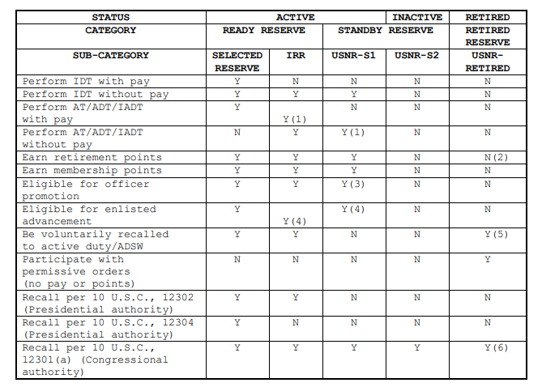
Navy Reserve Component Categories
Notes:
If authorized, ADT only.
Unless recalled to active duty in a retired status. If recalled, points are added to member's totals.
Except for flag rank.
If drilling in a non-pay unit and not subject to HYT.
Recall is in a retired status (no further promotion).
Recall as authorized by SECNAV.
* Chart from MILPERSMAN 1001-100 (Navy Reserve Status and Categories)
Notes:
FACILITATOR GUIDE:
TAR personnel are SELRES on active duty. So they are both Active and Reserve Component Sailors. Their benefits and requirements will be the same as active duty sailors as long as they remain in an active duty status. The only difference is they are paid from a different source of funding and are the same Branch Class (32) as the SELRES component.
SELRES not on active duty, drill (perform training) for points towards their retirement by completing their drill weekend requirements and annual trainings. Additional ways to obtain points towards retirement are available and they would get more information on those opportunities upon affiliation.
Voluntary Training Unit (VTU) members are compromised Sailors that have transferred from a SELRES status (i.e. beyond SELRES HYT limiting date for paygrade that do not have enough qualifying years towards Reserve retirement). Once they have met 20 qualifying years for retirement, then they will submit their request to retire and are moved into the Retired Reserve category. VTU members can still elect to voluntarily do Active Duty for Training (ADT), mobilize and/or perform funeral honors (receive pay).

Slide 13
Selective Reserves (SELRES) Benefits
Flexibility to pursue Civilian College/Career Goals but remain in the Navy
Pay-SRBs
SGLI/FSGLI
Advancement
Uniform Replacement
Medical/Dental Coverage-TRICARE/TAMP
Education Benefits-CLEP/Dantes
Tuition assistance (Pilot Program)
Navy COOL
USERRA/SCRA
MGIB-SR eligibility (requires 6-year contract)
Post 9/11 GI Bill Transferability
Exchange/Commissary/MWR
FFSC
"Space A" air travel
Mobilization Deferment
Active-Duty opportunities
Reserve Component Survivor Benefit Plan (RCSBP)
Reserve Retirement
BRS/TSP contributions
Notes:
FACILITATOR GUIDE: Resources as needed> 1) https://www.navyreserve.navy.mil/Onboarding/ 2) My Navy Reserve Homeport www.mynrh.navy.mil (find an NRC near home)
3) https://www.navy.com/joining/ways-to-join/reserve (covers benefits)
Reserve Pay Charts can be found at Defense Finance and Accounting Service > MilitaryMembers > payentitlements > Pay Tables (dfas.mil).
Service members are eligible for the Servicemembers’ Group Lift Insurance (SGLI), but depending on type of status (non-paid drilling for points or paid), the member may be responsible for paying the SGLI premium. Refer to Defense Finance and Accounting Service > MilitaryMembers > paydeductions > sgli > resguardpremiums > navy (dfas.mil).
Education Opportunities can include, but are not limited to Navy COOL, DANTES, … etc.
Uniform Entitlements
If service member has not completed their MSO (Military Service Obligation (i.e. 8 years)), upon affiliating with the Selected Reserves, they will not receive an additional entitlement until MSO is complete.
If service member has completed their MSO, they will be eligible to receive a full sea bag in addition to free alterations.
Post 9/11 GI Bill Transferability – To be eligible to transfer the Post 9/11 GI Bill, the member will need to complete a minimum of 6 years and OBLISERVE for an additional 4 years (10 total years) and as long as the dependent is in DEERS, the service member can transfer the Post 9/11 GI Bill. Just be aware that if member is reenlisting for only 4 years (in order to transfer Post 9/11 GI Bill) that they only have 30 days immediately following reenlistment to sign Statement of Understanding and submit their application within MILCONNECT.
RCSBP is a program administered by the DOD that allows the service member to leave a percentage of your future Navy Reserve retired pay as a monthly survivor annuity to your beneficiaries. This will guarantee your survivors a share of your military pay after the service member has passed. Refer to MyNavyHR-Career Management- Reserve Personnel Management – Reserve Retirements – RCSBP for further eligibility and options.
Some of these benefits can have limitations and once the Sailor is affiliated in the Reserves, they can speak with their NRA for more information on what their full entitlements are. This can change at any time and it is best to advise them to review the Navy Reserve Homeport (link found in quick links on MNP) and review the Reserves Onboarding information.

Slide 14
Selective Reserves Mobilization Deferment
Sailors transferring from Active Duty into the Selected Reserves qualify for a 2-year mobilization deferment
Deferment applies to all qualifying Sailors, regardless of active duty separation date
Sailors can choose to voluntarily mobilize at anytime.
Notes:
FACILITATOR GUIDE: ALNAVRESFOR 015/22 available on MYNRH website (www.mynrh.navy.mil / References / ALNAVRESFOR)
Deferment for mobilization is 24 months commencing on the Selected Reserve affiliation date. Best practice is to have your Sailor affiliate prior to getting off active duty via C-Way (or 1306/7) request. This would also ensure they are not losing out on their TAMP benefits. [Deferment policy does not apply to New Accession Trainees and Direct Commission Officers – recruited to be a SELRES asset, active duty status is temporary for IADT]
If Sailors do not affiliate prior to leaving active duty, they will lose out on TAMP benefits.
NOTE: Affiliation with the reserves with a break in service, will have the Sailors TIR recalculated for advancement purposes and possible ADSD adjustment IAW MILPERSMAN 100-030 and BUPERSINST 1430.16G. BRAKE in service means Sailor is not on contract (For example: Transition from IRR to SELRES status, the TIR has to be recalculated upon SELRES affiliation)

Slide 15
Selective Reserves Non-Regular Retirement
Navy Selected Reserve personnel can earn a Reserve retirement.
Must complete at least 20 qualifying years of service.
Qualifying years is based off the Sailor’s anniversary year, and it is unique to each person. For that year to be qualifying towards retirement they must earn a minimum of 50 retirement points (not to exceed 365 per year) within their anniversary year
Retirement points are earned from the following:
1 point for each day of active service
1 point for each attendance at a drill period (drill weekend drill periods, additional IDT, annual training periods)
1 point per day of funeral honors
15 points for each year of membership in a reserve component
Approved correspondence courses and processed with NRA
Retirement pay starts at age 60 or earlier depending on completed qualifying active-duty service.
Retirement pay is based on points earned. More points = more retirement pay.
Eligible for TRICARE for Life.
Notes:
FACILITATOR GUIDE: Active duty time does count towards a Reserve (SELRES) duty retirement. For example: 10 years active upon transfer to SELRES status, Sailor would serve remaining 10 years SELRES status but use the Retirement Point system to obtain qualifying year towards retirement. Understanding the "qualifying" retirement year system is important for transitioning sailors to learn.
QUALIFYING YEARS of service will be explained in the following slide but there is a difference in satisfactory years of service in the reserves and qualifying years towards retirement. The last six years must be completed in the reserves. See BUPERSINST 1001.39F page 20-2 and 20-3 for more information.
The Sailor can review their anniversary by accessing their Annual Retirement Point Record and Annual Statement of Service (ARPR/ASOSH) via BOL.
SELRES are mobilization assets and are required to be at the ready in time of need. Their administrative requirements are keeping their employment, address, recall, dependency changes, Family Care Plan, medical status or anything that can affect their ability to mobilize current and ensure the NRA is aware of any changes or issues so that they can update their mobilization status correctly. They will be briefed on this upon affiliation and will sign a Satisfactory Participation Requirement Record. Ensure that these Sailors read the document prior to signing so that they are fully aware. For more information on this refer them to the Navy Reserve Homeport, RESPERMAN 1001-010 and BUPERSINST 1001.39F.

Slide 16
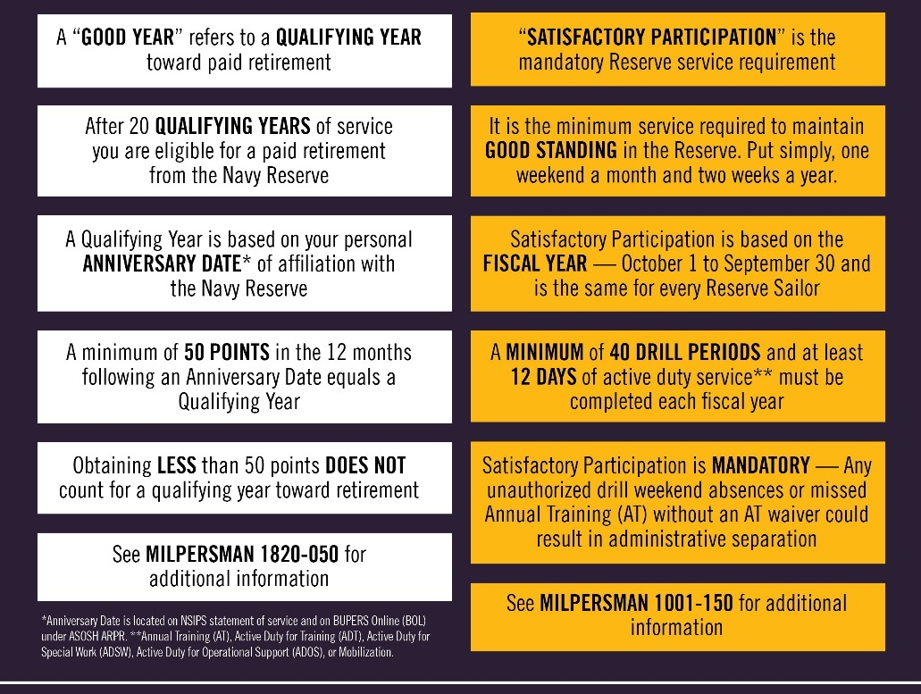
Selective Reserves Participation Categories
Notes:
FACILITATOR GUIDE:
I hope you find this table helpful in level-setting some foundational concepts for your Navy Reserve duties.
It is possible to earn a Qualifying Year while simultaneously having Unsatisfactory Participation.
It’s also possible to meet participation requirements within a Fiscal Year, but miss achieving a qualifying anniversary year toward retirement. You MUST manage both timeframes as you plan and execute your assigned duties.
A Sailor may have over 50 retirement points in an Anniversary Year, qualifying toward retirement, but have Unsatisfactory Participation.
Not completing an AT (and not having an approved AT waiver), or having more than nine unexcused drill period absences in the Fiscal Year OR a rolling twelve-month period yield. Unsatisfactory Participation, which could lead to administrative separation from the Navy Reserve.
“Unexcused absence from an annual training or from nine or more training units in a one year period often results in a discharge from the Reserve Component for failing to meet the training requirements.”
In other words, the member may have 50+ retirement points in an anniversary year, yielding a Qualifying Year, but have Unsatisfactory Participation due to no AT or >8 UAs, and may be ADSEP’d as a result.
Alternatively, a Sailor may take Authorized Absences or be approved for an AT Waiver within a Fiscal Year, yet fail to earn the requisite 50 Reserve Retirement Points within their unique Anniversary Year, missing eligibility.

Slide 17
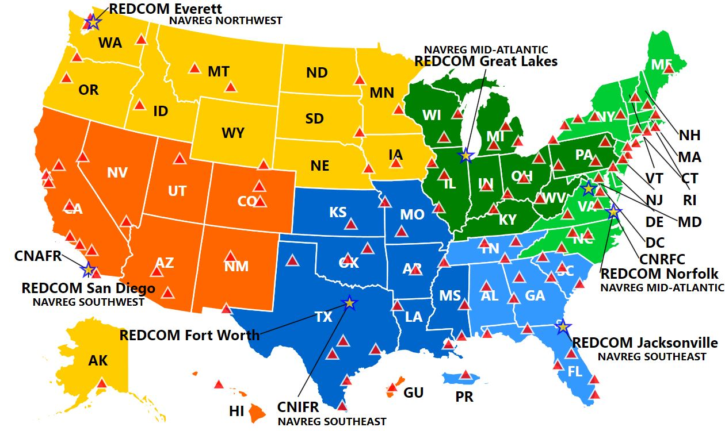
Selective Reserves Drilling Locations
Notes:
FACILITATOR GUIDE: CAN GO LIVE -> www.mynrh.navy.mil (look for "find a NRC") for updated map <-NO CAC REQUIRED.
Selecting one of the locations will give the name of the NRC, phone number, facebook website, all without CAC requirement, also gives the NRC SharePoint weblink (weblink requires CACID – however, can obtain POM, drill dates, department POCs, address, etc.)
Where the Sailor is moving to is generally where the Reserve Center will be. There is at least one Reserve Center in each state- the RPAC TA will assign the best fit within that state.
All NRC command websites are hosted on the My Navy Reserve Homeport Website: (CAC Required) From the MYNRH main page, the Sailor can either search for the command in the search bar or navigate to the individual command via the “COMMAND” drop-down menu at the top of the page, followed by “REGIONS” to select the appropriate, and then the name of the NRC. Each NRC website provides a wealth of information specific to the command.
As part of your initial contact with the Navy Reserve Center staff, you will receive a Welcome Aboard Package that will provide basic information about the facility including:
• Facility address and entry instructions • Command directory • Drill Schedule • Hours of operation • Instructions for Meals and Berthing • Holiday schedule • Weather contingency plan • Website address
NRC MAP: https://www.mynrh.navy.mil/#/map

Slide 18
Selective Reserves Reserve Processing and Affiliation Center (RPAC)
From The Fleet To The Navy Reserve Center
The RPAC facilitates the transition of Active Duty/ Training and Administering the Reserves (TAR) enlisted service members to the Selected Reserves through:
Transition requests that are completed by the Sailor and CCC
The RPAC is a conduit between the Sailor and the Reserve Center to make the transition as smooth as possible.
Career Waypoints (C-WAY) or
NAVPERS 1306/7
Notes:
FACILITATOR GUIDE:
Not to be confused with the Career Transition Office. CWAY is the main way to complete the conversion. If Sailor is within 90 days of Separation without a CWAY quota they will use the route of submitting an EPAR with the Commanding Officer’s endorsement to the SELRES ECM.
https://www.mynavyhr.navy.mil/Career-Management/Community-Management/Enlisted/Selected-Reserves/

Slide 19
Selective Reserves Reserve Processing and Affiliation Center (RPAC)
The TA will work directly with CCC’S & SAILORS:
They will help prepare and expedite documents
The TA will be the POC regarding Navy Reserve programs, policies, and transition:
Bonus Eligibility
24 Month Deployment Deferment
TAMP & Tricare Reserve Select
SGLI
Reserve Retirement and more
RPAC EMAIL:
rpac.enlisted.fct@navy.mil
OR CALL 901-874-4108
Notes:
FACILITATOR GUIDE:
Think of the Transition Assistant (TA) as the transition Sponsor for the Sailor.

Slide 20
Transitional Assistance Management Program (TAMP)
Provides 180 days of premium-free TRICARE transitional health care benefits after regular TRICARE benefits end.
Starts the day after you separate from Active Duty.
Not automatic, as individuals must meet one of the six qualifying criterion as described below:
Involuntarily separated from active duty under honorable conditions.
A reservist separated from active duty after serving more than 30 days in support of a contingency operations/COVID-19 response/preplanned mission.
Separated from active duty following involuntary retention (stop-loss) in support of a contingency operation.
Separated from military service following a voluntary agreement to remain on active duty for 1 year or less in support of a contingency operation.
Receiving a sole survivorship discharge.
Separated from active duty and agreed to become a member (affiliate) with the Selected Reserve the day following the last day of active duty.
Notes:
FACILITATOR GUIDE:
During TAMP, the service member and their family members are eligible to use on of the following health plan options in addition to military hospitals and clinics:
- TRICARE Prime (where locally available)
- TRICARE Select
- US Family Health Plan (if you live in a designated location)
- TRICARE Prime Overseas
- TRICARE Selected Overseas
Other active duty programs such as the Extended Care Health Option (ECHO) are also available during the TAMP period.
-By transitioning via the RPAC, service members are more likely to avoid a break in active participation (i.e., Active Duty or SELRES) and become eligible for 6 months (180 days) of family Tricare benefits (same benefits enjoyed by Active Duty members). After the 6 months, service members can then enroll in Tricare Reserve Select for the remainder of their SELRES career. -Service members who qualify for Transitional Assistance Management Program (TAMP or TA-180), receive dental care under the Tricare Active Duty Dental Program for 6 months. After 6 months, service members may opt to receive coverage under the Tricare
Dental Program for Guard and Reserve service members. Eligible family members may purchase dental coverage separately.
During terminal leave, service members aren’t eligible for TAMP and should be covered under TRICARE Prime, TRICARE Prime Remote, or TRICARE Select.
All transition health care can be found below:
www.Tricare.mil/mybenefit

Slide 21
Selective Reserves CCC Role for SELRES Affiliation
CAREER DEVELOPMENT BOARD (C-Way, Separation, MNA)
Discuss Reserve benefits for separating/undecided Sailors.
Update Career Intentions in CIMS, C-Way and MNA.
Submission of AC2RC Quota in CWAY
RPAC Transition Assistant (TA)
RPAC TA reaches out for documents to be submitted.
If Sailor does not have MSO time left, reenlistment contract is signed with RPAC TA.
Point of Contact that is working the case will reach out to the Sailor.
CCC to assist member in completing documents:
NAVPERS 1306/97: Reserve Affiliation Screening Checklist and contact information sheet.
SELRES Enlistment Contract/ PG13s as required.
Notes:
FACILITATOR GUIDE:
1. Sailors will receive an email from their TA once an approval quota is issued. Sailors will work with their TA (kind of like a sponsor) to help with the transition and what paperwork will be needed from them.
2. The Reenlistment paperwork is part of the package the TA will need from the Sailor. So make sure to work hand-in-hand with the Sailor and the RPAC TA.

Slide 22
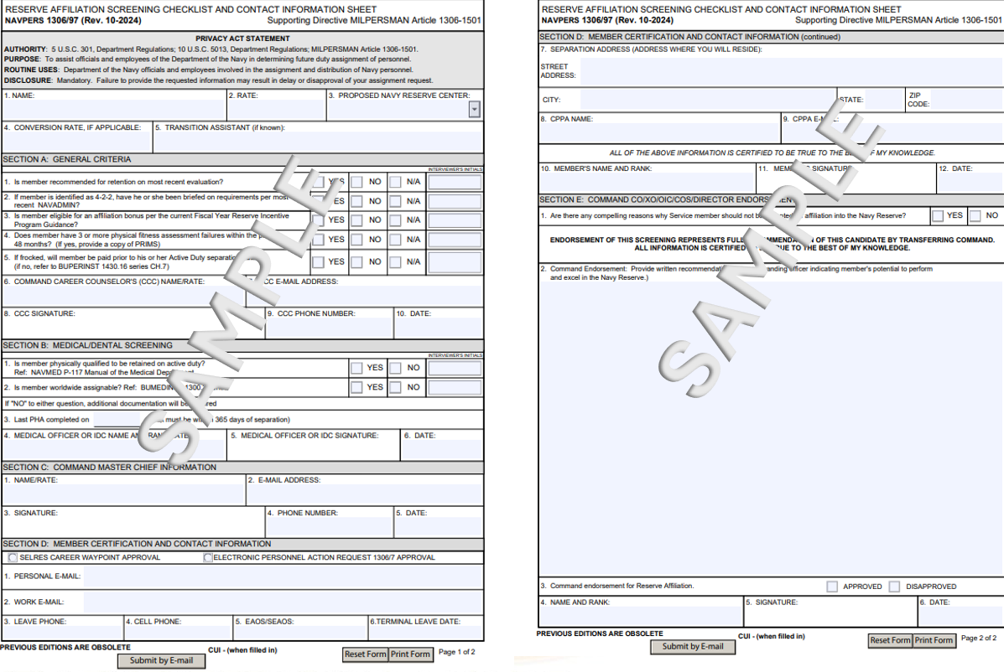
Selective Reserves NAVPERS 1306/97

Slide 23
Knowledge Check
What are the Navy Reserve Categories?
Explain the 4-2-2 Military Service Obligation.
List five benefits of the SELRES.
If a Sailor joins the SELRES regardless of active duty separation date, how long will their involuntary mobilization deferment be?
Notes:
ANSWERS:
SELRES, IRR, RETIRED
For Active/TAR Sailors joining active duty on/after 10/1/2020 (DDFORM4), when they do not remain past 4 years in active duty status, will be transferred to SELRES status (by CC) to serve at least 2 years and then they can elect to transfer to IRR for 2 years. NOTE: In other words, anything less than 6 years in active duty status, will require these Sailors to be transferred to SELRES status. [Assuming their rate exists in SELRES, there are a few rates that doesn't exist SELRES].
Flexibility, Pay, SGLI, Advancement, NEC opportunities, Educational Opportunities – SELRES TA, MGIB_SELRES (Chapter 1606), Navy COOL, Camraderie (networking for employment opportunities) 4.
Two years

Slide 24
Summary and Review
In this lesson we discussed:
The role of the Career Counselor regarding the Navy Reserves
Purpose of the Navy Reserves
Listed the Navy Reserve categories
Benefits of the Navy Reserves
The functions of the Reserve Processing and Affiliation Center (RPAC)

Slide 25
Questions?

